Slide 1
Generative AI and the Practice of Law
Practice Innovation Attorney Interview
November 11, 2025
Leland Sampson
Notes:
Hi, my name is Leland Sampson. Thank you for joining me today for a presentation about generative AI and the practice of law.

Slide 2
Roadmap
What is GenAI?
Attention is all you need
The next frontier: reasoning models
Hallucinations and accuracy
AI and the law: beside, inside, outside
Notes:
This presentation touches on several topics in in abbreviated form. I will distinguish generative AI from other types of AI, describe the research paper that sparked classical GPTs, briefly describe the reasoning models that are the current state of the art, discuss hallucinations and accuracy throughout, and wrap up with why I think every lawyer needs to pay attention to AI

Slide 3
What is AI?
Computer systems able to perform tasks that normally require human intelligence
Notes:
So what is AI? Broadly defined, AI is the ability of computer systems to perform tasks that normally require human intelligence.
https://www.oxfordreference.com/display/10.1093/acref/9780198609810.001.0001/acref-9780198609810-e-423

Slide 4
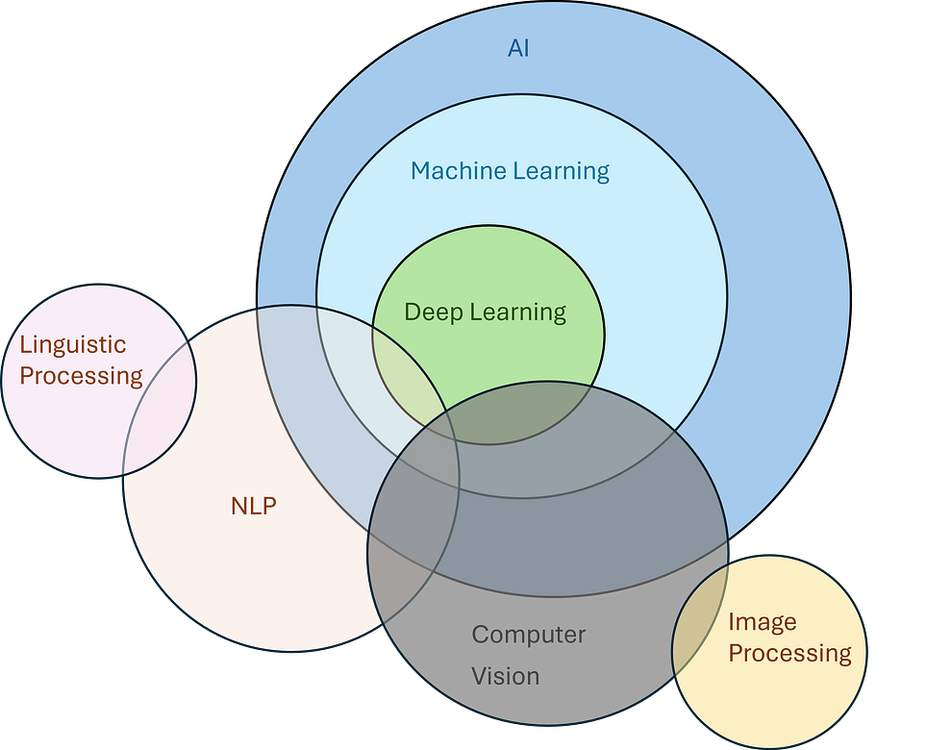
Notes:
This diagram provides a good visual that categorizes computer tasks that we would normally associate with human intelligence. Let’s look at some examples.
https://medium.com/@jainpalak9509/breakdown-simplify-ai-ml-nlp-deep-learning-computer-vision-c76cd982f1e4

Slide 5
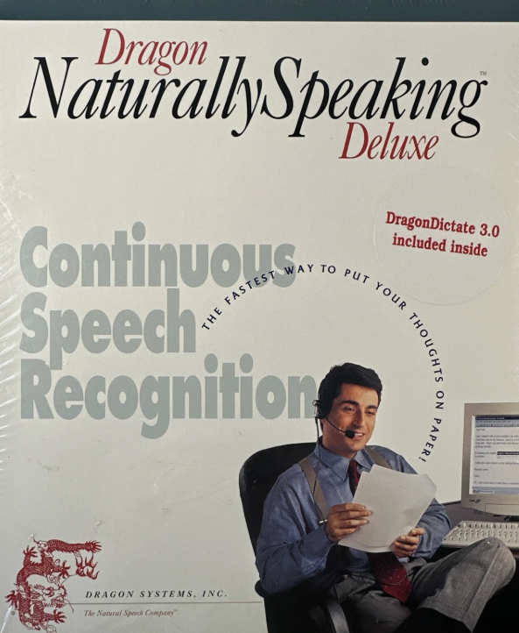
Speech to text
Notes:
Consider a natural language processing app that does text to speech, such as Dragon Naturally Speaking. This software is deterministic. For the same input, the user would get the same output.
https://www.ebay.com/itm/326201828484?chn=ps&google_free_listing_action=view_item

Slide 6
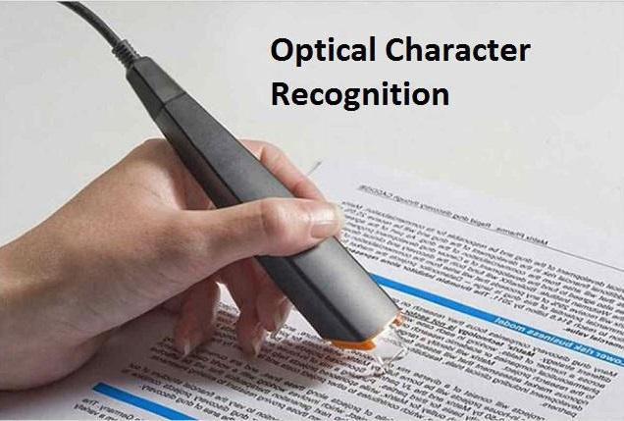
Optical Character Recognition
Notes:
The same for optical character recognition. This form of computer vision can be done using algorithms and heuristics with predictable outputs.
https://www.openpr.com/news/2057056/optical-character-recognition-ocr-market-survey-report-2020

Slide 7

Generative AI chatbots
Notes:
https://www.openpr.com/news/2057056/optical-character-recognition-ocr-market-survey-report-2020
Chatbots like ChatGPT are examples of deep learning AI where, the output is probabilistic and the same input may yield different outputs.

Slide 8
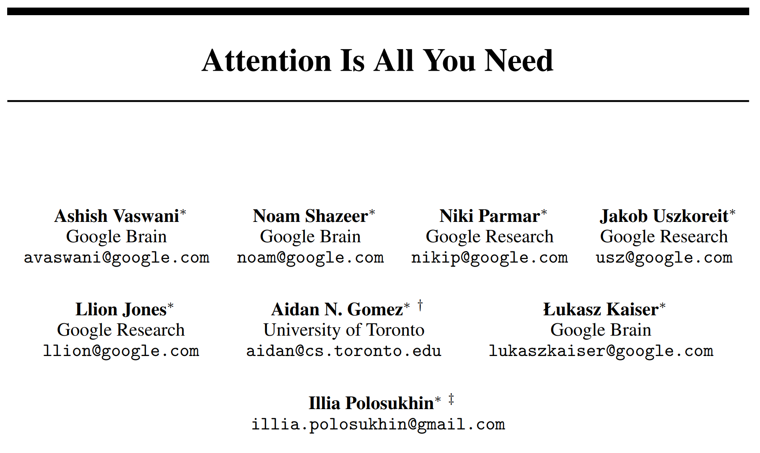
Notes:
AI research is older than the transistor. This is the paper that proposed the Transformer in 2017 and sparked the current AI summer..
https://arxiv.org/pdf/1706.03762

Slide 9
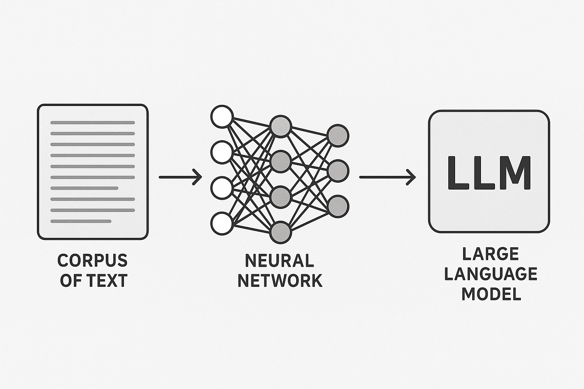
Training a LLM
Notes:
Using the Transformer described in the paper, computer neural networks were built by analyzing trillions of associations between words. The weights associated with these relationships became known as large language models or LLMs for short.
Image generated by ChatGPT

Slide 10
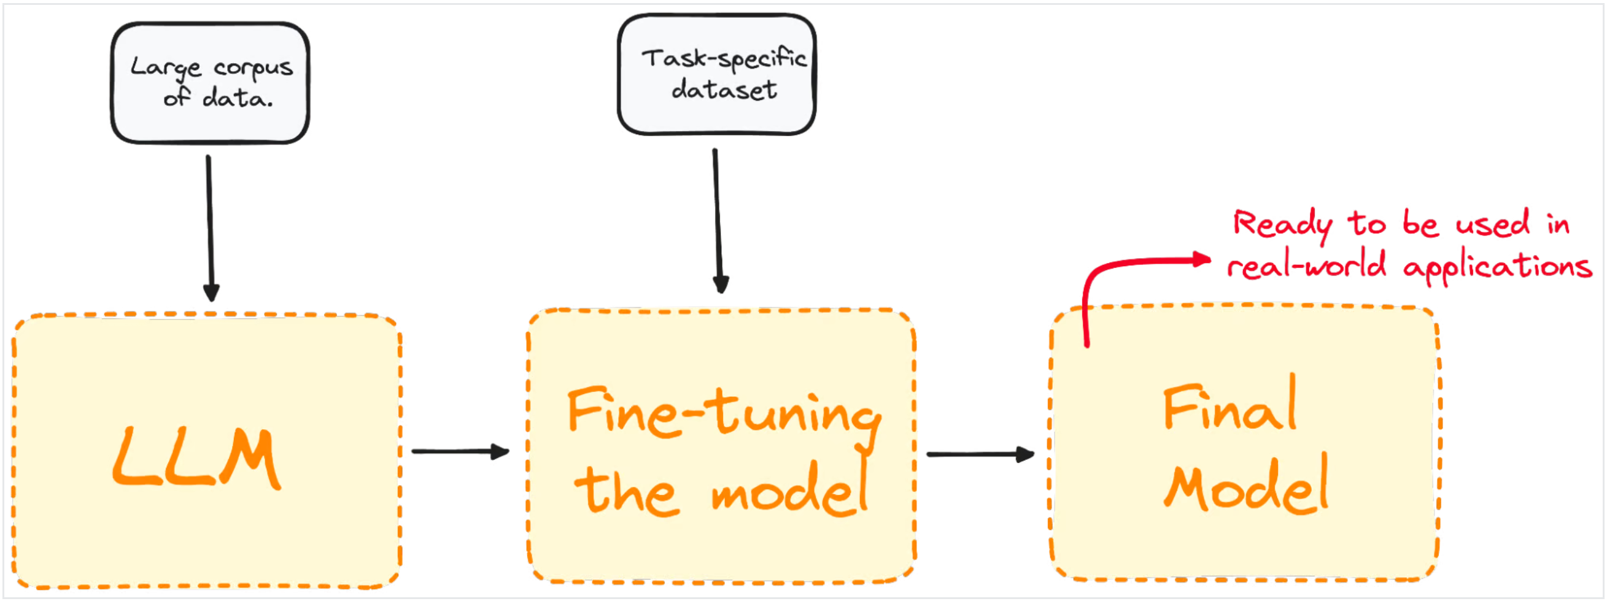
Fine-Tuning
Notes:
All LLMs are fine-tuned before they are used. The response to a prompt is scored by a human and the LLM tries again. The scoring affects the model weights and influences all future outputs.
https://www.datacamp.com/tutorial/fine-tuning-large-language-models

Slide 11
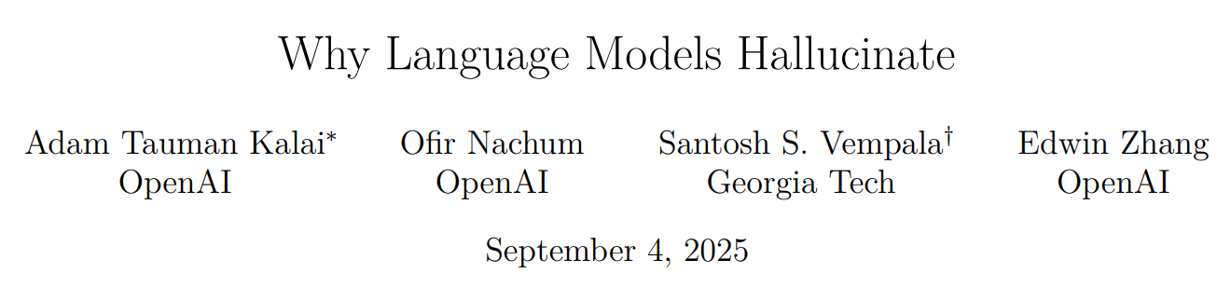
Notes:
Another great research paper on why LLMs hallucinate suggests that the problem is the incentives of benchmarking and fine tuning. The way benchmarks work, the LLM is rewarded for guessing and so it scores higher, but at the cost of inaccuracies like hallucinations.
https://arxiv.org/pdf/2509.04664

Slide 12
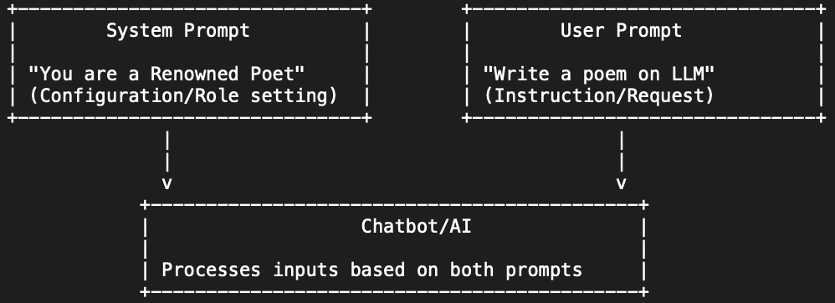
System prompts
Set of instructions, guidelines, and additional contextual information that defines how LLM responds to user prompt.
Notes:
System prompts are sets of instructions and guardrails that tell the LLM how to respond to a user prompt. As an example, Anthropic publishes the system prompt for their chatbot Claude and the system prompt has a guardrail that says Claude “does not provide information that could be used to make chemical or biological or nuclear weapons.
https://promptengineering.org/system-prompts-in-large-language-models/
https://generativeai.pub/understanding-system-and-normal-prompts-in-llm-how-they-work-and-differ-df9ea490546c
https://docs.claude.com/en/release-notes/system-prompts

Slide 13
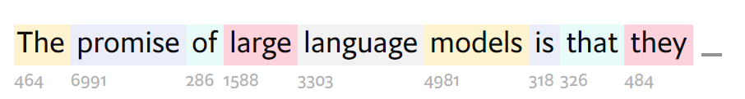
Tokenisation – Turning words (or fragments of words) into numbers
Notes:
Now let’s look at how a LLM picks the next word in an output. First, words are transformed into tokens.
Visual taken from https://www.economist.com/interactive/science-and-technology/2023/04/22/large-creative-ai-models-will-transform-how-we-live-and-work

Slide 14
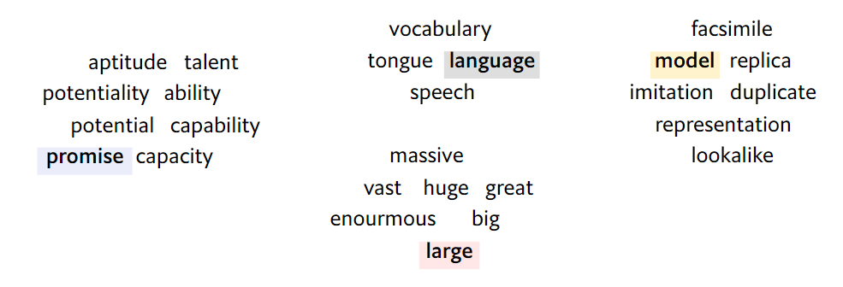
Embedding – Tokens are mapped to vectors that carry meaning
Notes:
Next the tokens are assigned a vector that comes from the training set. This begins the process of teasing out meaning, Similar words have similar vectors. it’s called embedding.
Visual taken from https://www.economist.com/interactive/science-and-technology/2023/04/22/large-creative-ai-models-will-transform-how-we-live-and-work

Slide 15
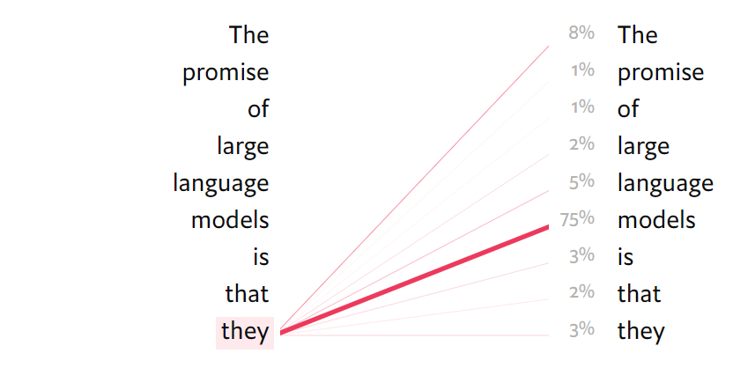
Attention – Range of words that could come next. The range is dynamic in relation to the words that came before
Notes:
Attention was the innovation of the 2017 paper and it allows the LLM to capture meaning and relationships even between words that are far apart in a text. LLMs do the same attention task in parallel looking at different parts of the text. It’s the parallel nature of attention has made nVidia a 5 trillion dollar company.
Visual taken from https://www.economist.com/interactive/science-and-technology/2023/04/22/large-creative-ai-models-will-transform-how-we-live-and-work

Slide 16
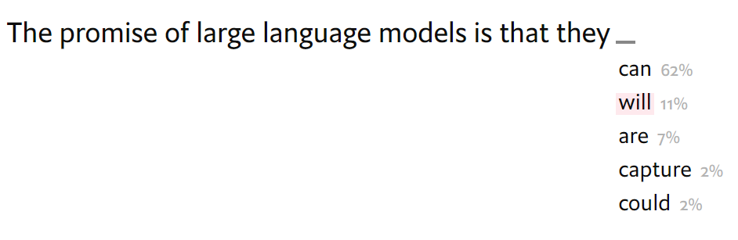
Temperature – how “creatively” the model picks the next word
Notes:
There are many nobs to adjust in an LLM, but temperature is one of the easiest for users to understand and tweak. Increasing the temperature will increase the randomness and result in more creativity at the cost of more hallucinations.
Visual taken from https://www.economist.com/interactive/science-and-technology/2023/04/22/large-creative-ai-models-will-transform-how-we-live-and-work

Slide 17
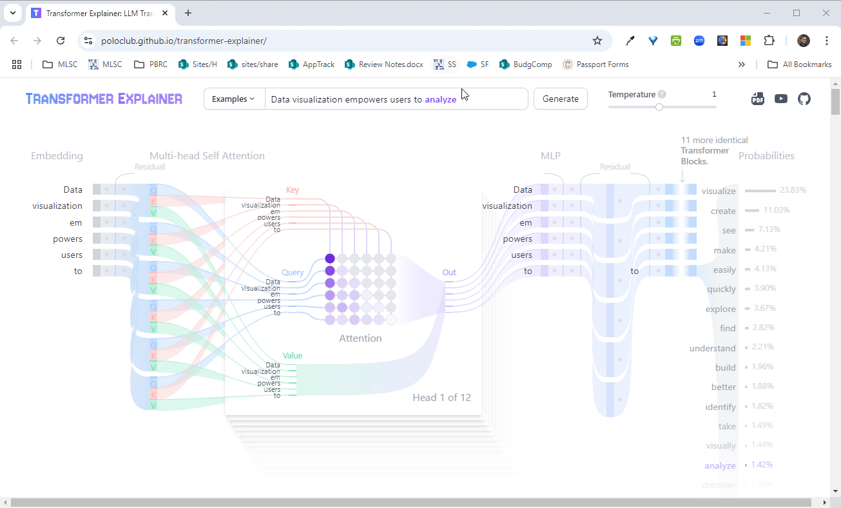
See it in action
Notes:
This website uses the GPT 2 model to visually show you how the LLM is generating the next word in a sentence. I suggest you play with it, it’s very fun.
https://poloclub.github.io/transformer-explainer/

Slide 18
We have a toddler that can talk, but sometimes it hallucinates - now what?
Notes:
So this bot can speak coherently, but what does that get you? It only “knows” things from its training data and the temperature that makes it creative can make things up. How to we get knowledge into the bot?

Slide 19
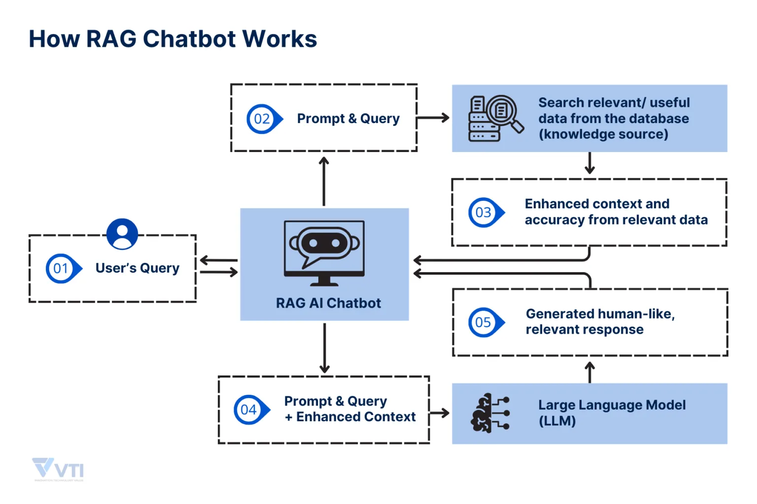
Notes:
One common approach is Retrieval Augmented Generation. Here, the user’s prompt first goes to a search tool that finds relevant information in a knowledgebase. The original prompt and context taken from the knowledgebase then go to the LLM for processing and the user gets an output.
https://vti.com.vn/a-comprehensive-guide-to-rag-genai

Slide 20
Limits of RAG
Limited by search appliance and knowledge source
Distraction
The answer (or relevant info) gets lost in the noise
LLM ignores the RAG info and relies on it’s parametric memory
Notes:
RAG can be useful, but the user quickly discovers the limits. If the front end search or knowledge base are poor, outputs will likewise be useless. If the answer is one small needle in the haystack the LLM might not find it for the output. Also, the randomness of the LLM can sometimes cause it to ignore the knowledge source and use the output from it’s parametric memory that comes from it’s training data.

Slide 21
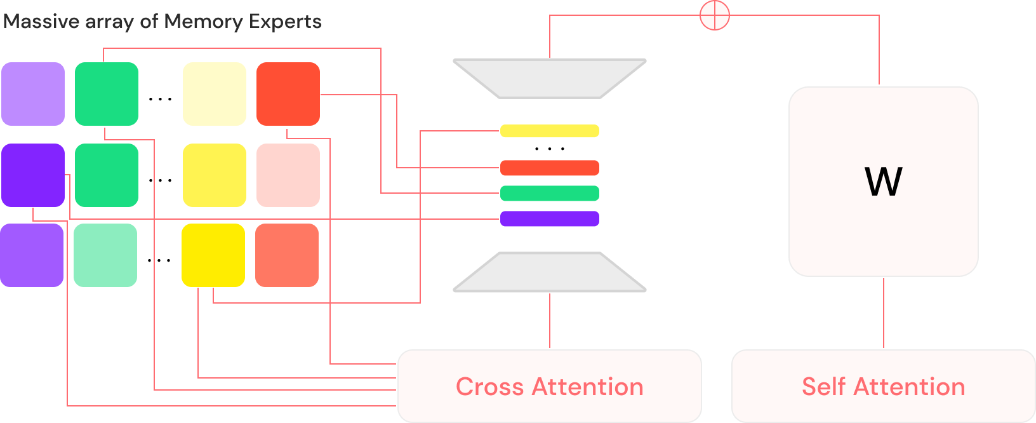
Massive array of Memory Experts (MoME)
Notes:
The massive array of memory experts is another attempt to improve outputs. Here an LLM has thousands of small SLMs fine tuned on specific areas of knowledge. For example there may be model trained on the UCC statutory text, another on cases involving the UCC, etc. Here, the LLM is an orchestrator that picks which SML is appropriate for a subset of the prompt. The SLM generates an output and those tokens are used to increase the context of the original prompt. Eventually the orchestrating LLM provides a response.
https://arxiv.org/html/2406.17642v1

Slide 22
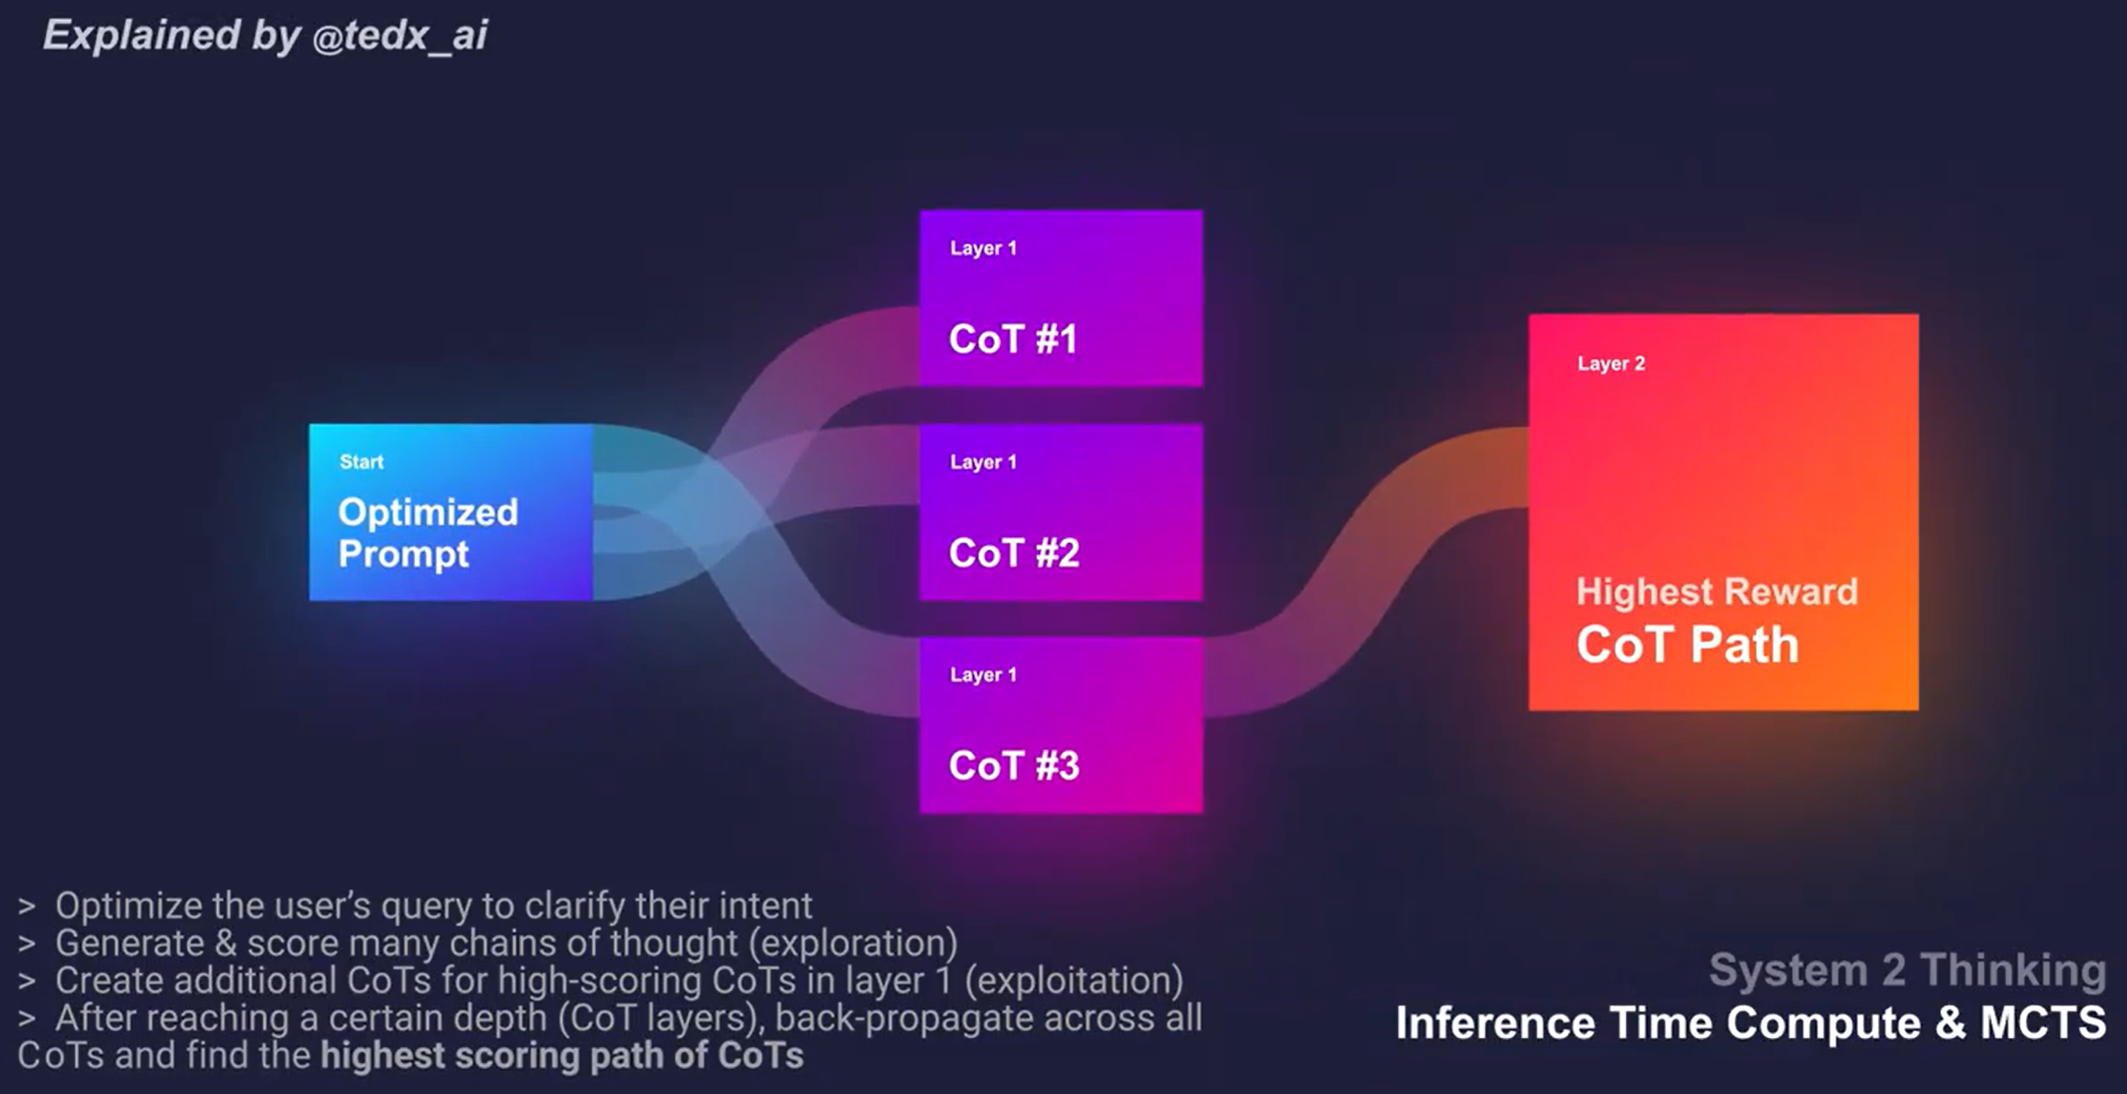
Reasoning model architecture
Notes:
Reasoning models are the next frontier. This approach breaks prompts down into chains of thought where the LLM steps through the response many times. Another part of the LLM evaluates the chains of thought and picks the best one. When the models say the are “thinking”this is what’s going on in the background.
https://x.com/tedx_ai/status/1834346066482987340

Slide 23
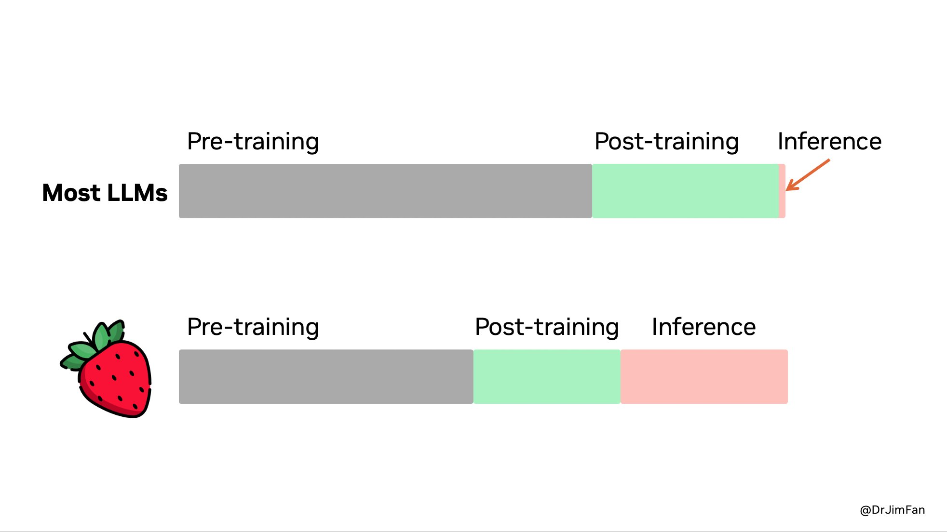
Reasoning model architecture – energy use
Notes:
The reasoning models are using compute resources when the prompt is processed. Classic LLM models take a lot of resources to train but then the marginal cost to generate tokens is minimal. The reasoning models use significant amounts of processing power to produce and evaluate the chains of thought. And this means the marginal cost of generating outputs is a lot higher.
This energy cost is why big tech companies are leasing nuclear reactors to fuel their AI datacenters.
https://x.com/DrJimFan/status/1834279865933332752/photo/1
7 minutes

Slide 24
As lawyer, why should I care?
Notes:
For the last section of our time together, I want to explain what I think all this has to do with the practice of law.

Slide 25
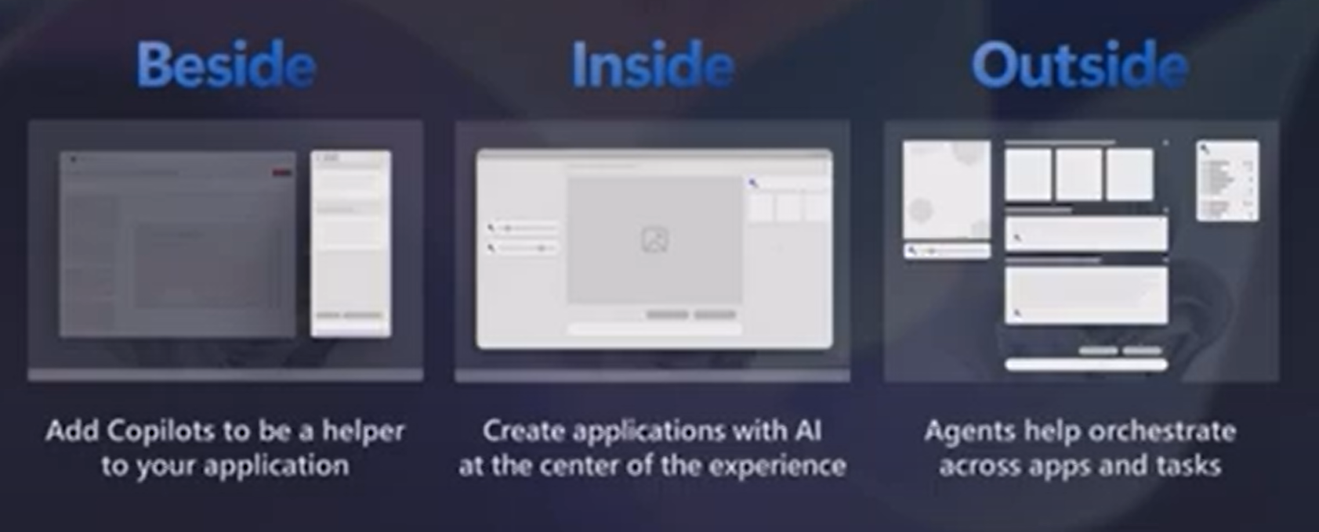
Beside, Inside, Outside
Notes:
First I need to introduce a concept called beside, inside, and outside. This defines the way lawyers intact with generative AI. A chatbot like Claude sits beside the user. The user has to enter a prompt, give it some data, get an output, then copy that output into their Word document. This is a return to the command line interface. You don’t have to know specific commands and syntax, but the volume of context you have to dump into the prompt increases the friction of the interaction.
Increasingly we are seeing AI integrated inside of apps, such as Copilot in Microsoft Word. Menus and user interfaces will be simplified and apps will perform complicated tasks in with simple commands. Imagine telling Word to build a table of authorities for your brief automatically.
I don’t think you can buy a piece of legal tech software that doesn’t claim to have some AI magic.
Eventually, the AI interface will sit outside of your apps and data. The interface will be an agent that is aware of the context in which you are working. Based on data feeds like email and shared repositories like SharePoint, systems will proactively ask you if you want it to accomplish a task or take an action. The agent will then orchestrate your apps and data to accomplish the task.
https://www.youtube.com/watch?time_continue=205&v=h41Uc73xph4

Slide 26
Rules of Professional Conduct
Rule 1.1
To maintain the requisite knowledge and skill, a lawyer should keep abreast of changes in the law and its practice, including the benefits and risks associated with relevant technology.
Rule 5.1,
Supervising attorneys must ensure, “the firm has in effect measures giving reasonable assurance that all lawyers in the firm conform to the Rules of Professional Conduct.”
Database of instances where attorneys have been sanctioned for misuse of GenAI
Notes:
Modern practice of law requires using computers. Rule 1.1 of the Rules of Professional Conduct require that lawyers remain abreast of the risks and benefits of technology. Supervising attorneys also have a duty to ensure the firm has things like AI policies to govern ethical use. The flurry of attorneys being sanctioned for the inappropriate use of GenAI systems shows the downside risks. If the systems that we use to practice law are infused with generative AI, then I think some knowledge of it is not only advisable, but mandatory for all attorneys.
https://www.americanbar.org/groups/professional_responsibility/publications/model_rules_of_professional_conduct/rule_1_1_competence/comment_on_rule_1_1/
https://www.americanbar.org/groups/professional_responsibility/publications/model_rules_of_professional_conduct/rule_5_1_responsibilities_of_a_partner_or_supervisory_lawyer/
https://www.damiencharlotin.com/hallucinations/

Slide 27
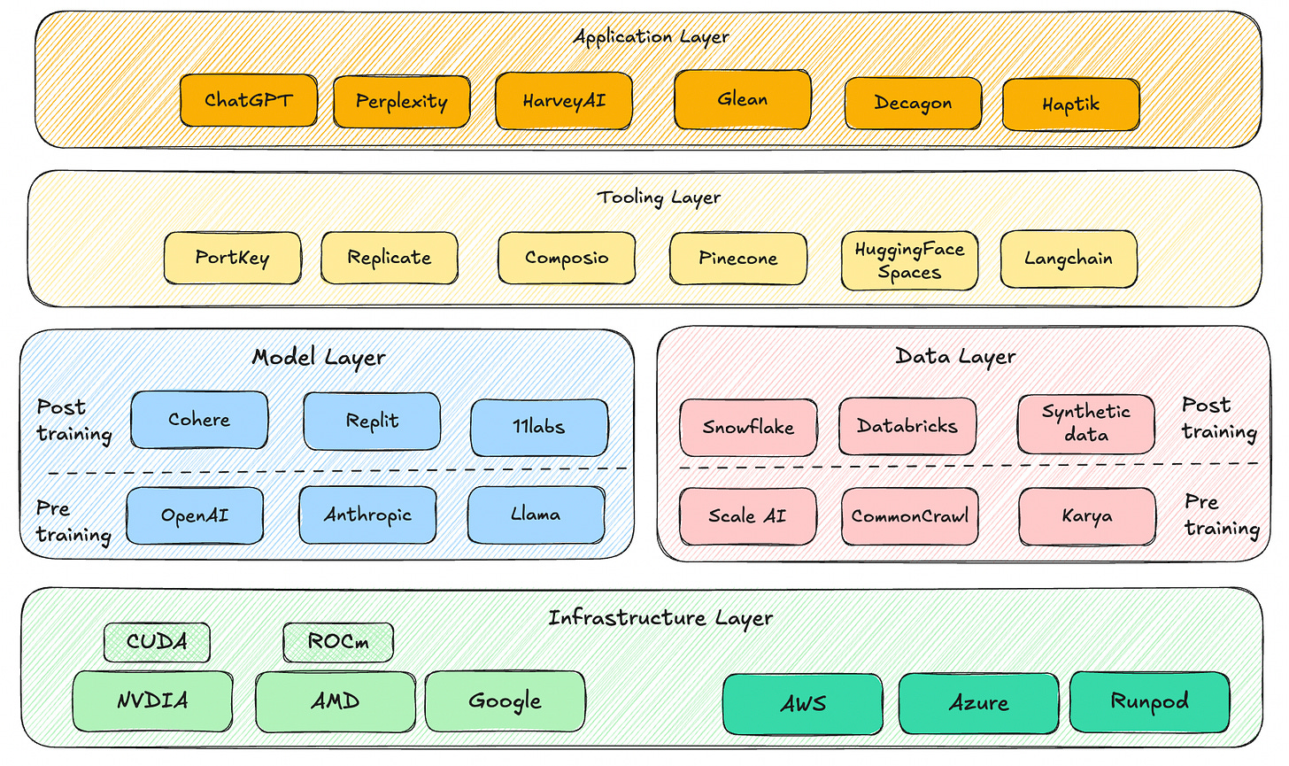
Notes:
The last little bit of detail that I want to end on is that the application layer that you’re working at with Harvey and Perplexity is the just the tip of the AI stack. There are opportunities for innovation at all levels of the ecosystem.
https://www.srajdev.com/p/the-ai-stack

Slide 28
Thank you for watching!
Notes:
That is the end of my presentation, thank you for your attention.
9:30

